Slide 1
Content Objective: Students will research current uses of AI data reasoning and use a model that depicts machine learning
Thursday June 20th
Recap Yesterday
Work on Data Reasoning Research
Machine Learning / Student-Master Dilemma
Homework
No homework in the course. But I will make you think!

Slide 2


Data Representation / Reasoning
What were the problems with how the AI program “PerfectMatch” paired pet buyers with a pet?
We took “training data” that included the 17 students in our classroom. The AI has discovered that people with an Asian ethnicity love Pomeranians! What was the issue with this?

Slide 3

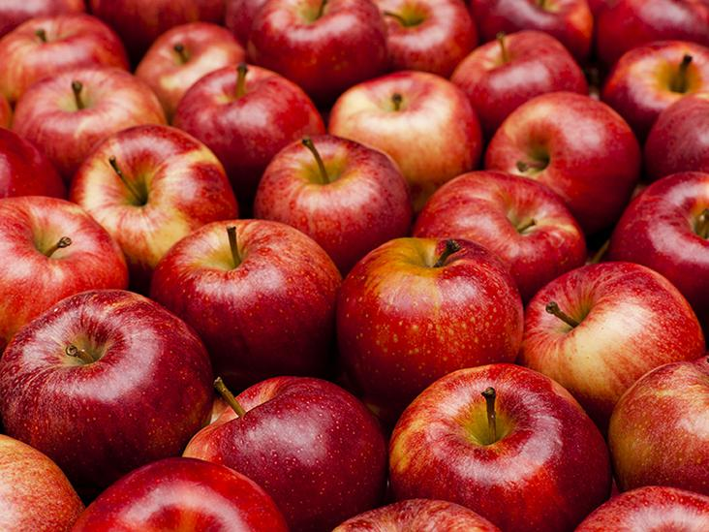
Data Interpretation
How many apples will 3 kids get if you have 12?

Slide 4
Data Representation / Reasoning - Ethical Dilemmas
Choose a topic to research...
Just like before we will make little posters and you will “teach” these subjects to the class…(groups that did not go last time will go this time)
Uygur Muslim Humanitarian Crisis in China
Autonomous Weapons
China’s “Social Credit” System (Coming to America?)
Deep Fakes / New Age Propaganda

Slide 5
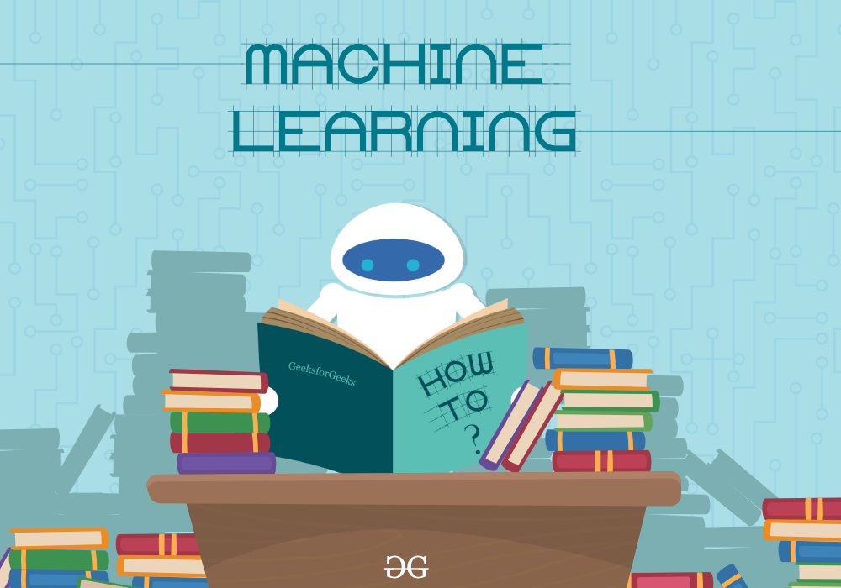
Machine Learning
Go to this website -
https://teachablemachine.withgoogle.com

Slide 6
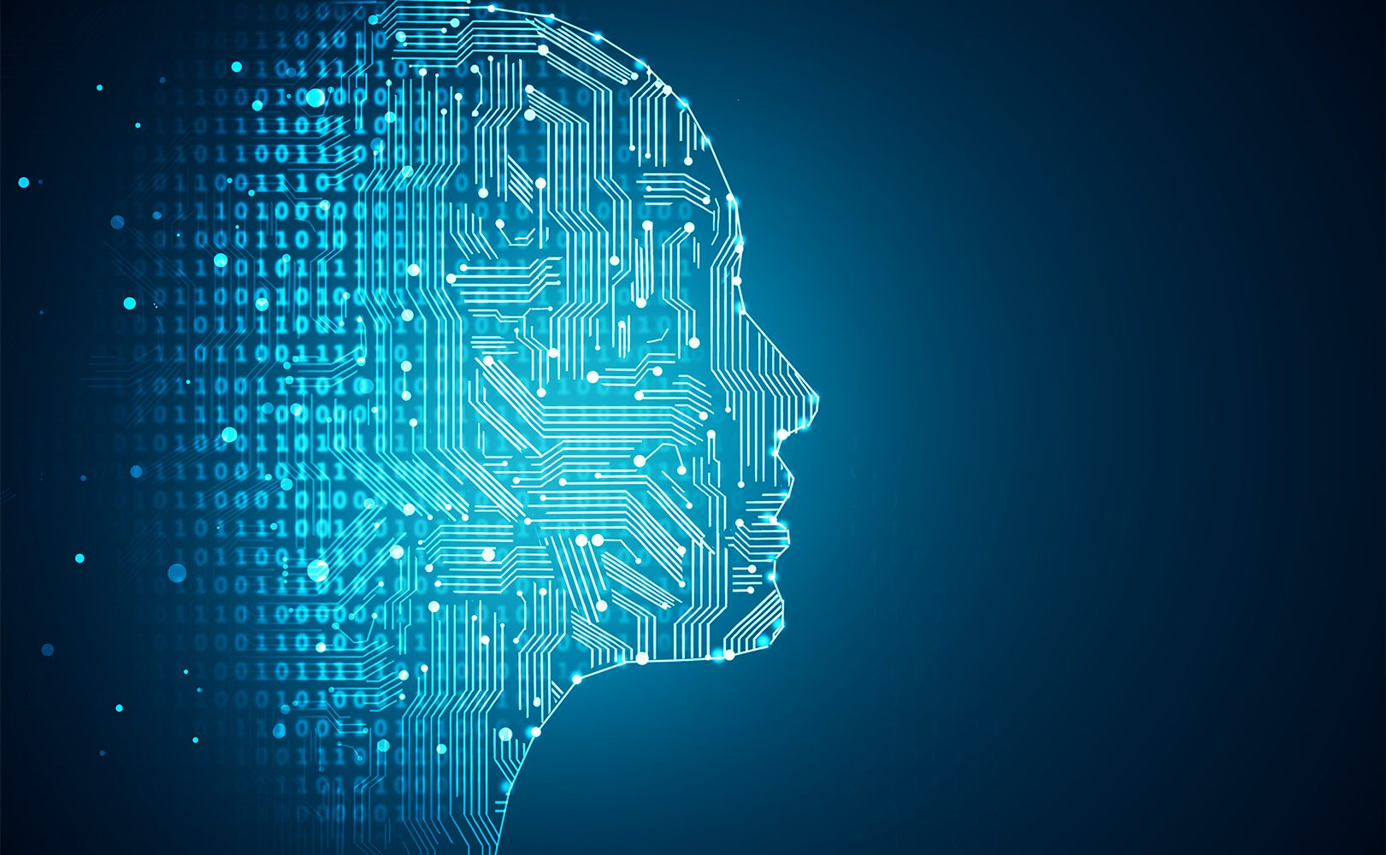
Machine Learning Levels
Pick one to teach the class....
Narrow Intelligence
General Intelligence
Super Intelligence

Slide 7

Ethics of Machine Learning
The “Student - Master” Dilemma

